Slide 1
Crafter’s Mask Detector
By Team Code Crafters
Where Coding Meets Art !

Slide 2

Nothing Serious , Just Relax !
A Blissful Yoga Day
21st June 2020

Slide 3
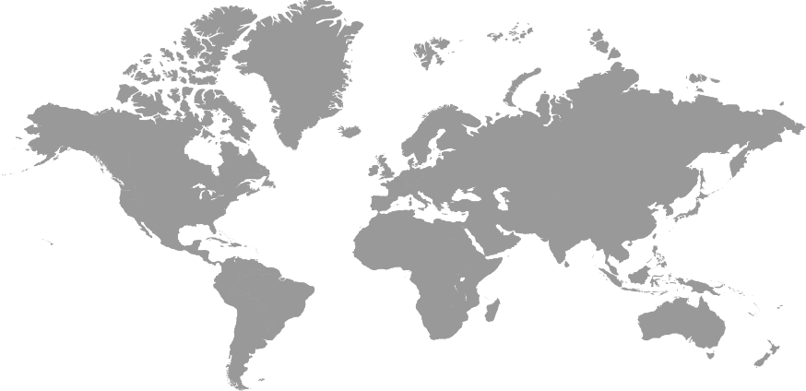
COVID-19 I N WORLD
303 K
577 K
2.3 M
395K
7.4 K
780 K

Slide 4



Problem To Solution Approach
Economy
PLAN
For Economic Activity to grow Our Shops needs to function
Mask Detecting Module
OBSERVATION
Small Business
Easy
People Can’t Afford costly modules to observe crowd
To Use
Difficulty In Crowd Management
Fast
&
Reliable
Less Manpower
They don’t have enough manpower to monitor the crowd

Slide 5
The Machine Learning Model
Voice Assistant
Mask Detection
Once Confirmed The Person is informed the result through Voice Assistant
The Detected Face Is Passed To Our Model Which Returns The Probability On Mask Or No Mask Parameters
Training
Trained Our Model Using Google Colab
Bounding Box
6
Face Detection
4
The Bounding Box Displays a square box to indicate the result
Data Sets
2
1500 With & Without Mask Images
Face Detection Using Open Source Computer Vison
5
1
3

Slide 6
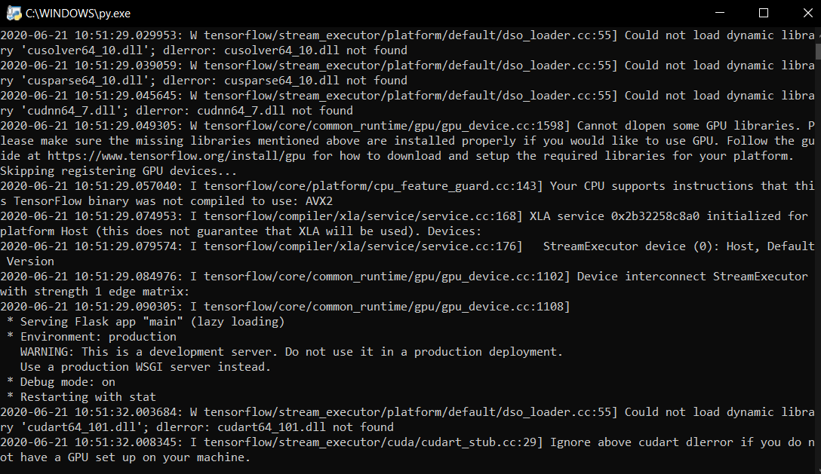
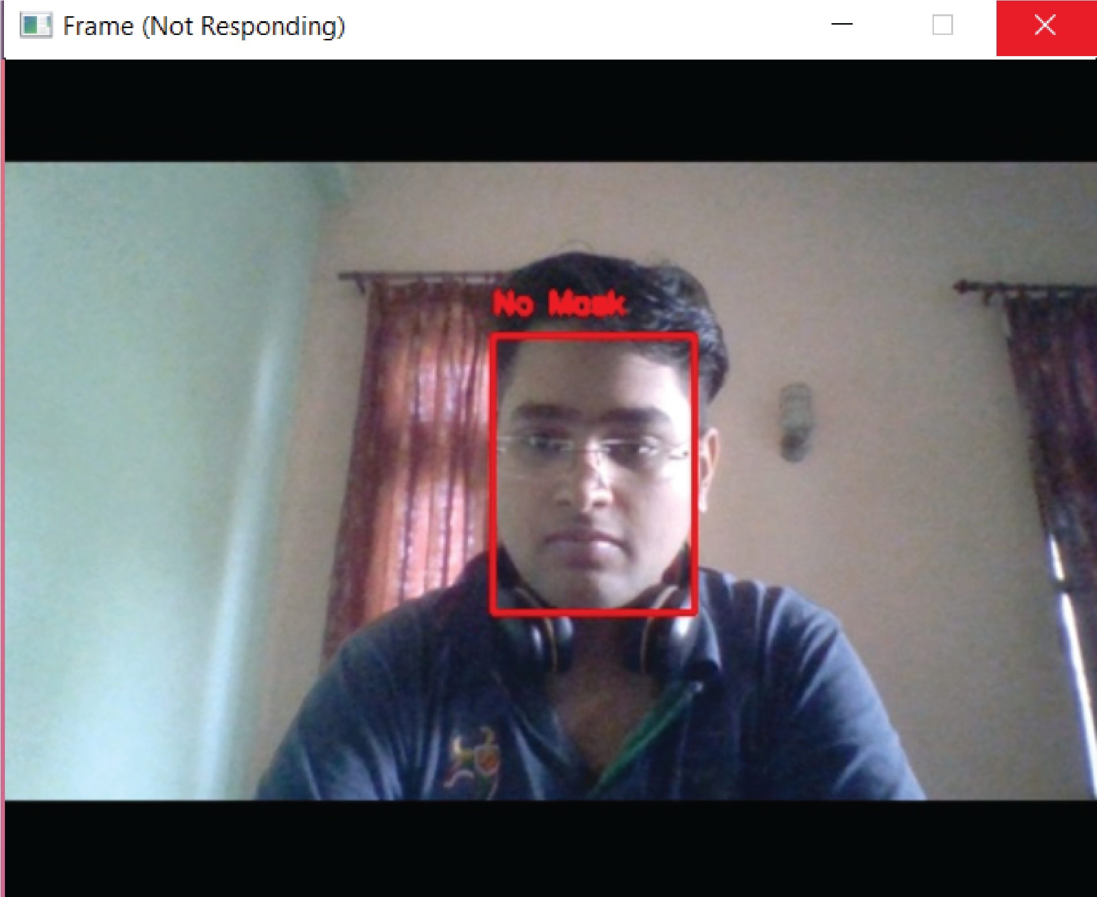
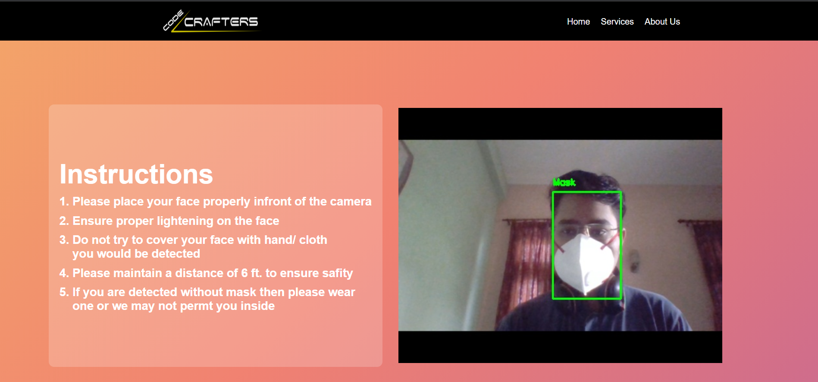

The Sophisticated Look !

Slide 7




The Front-End
HTML
CSS
Bootstrap
Blender

Slide 8
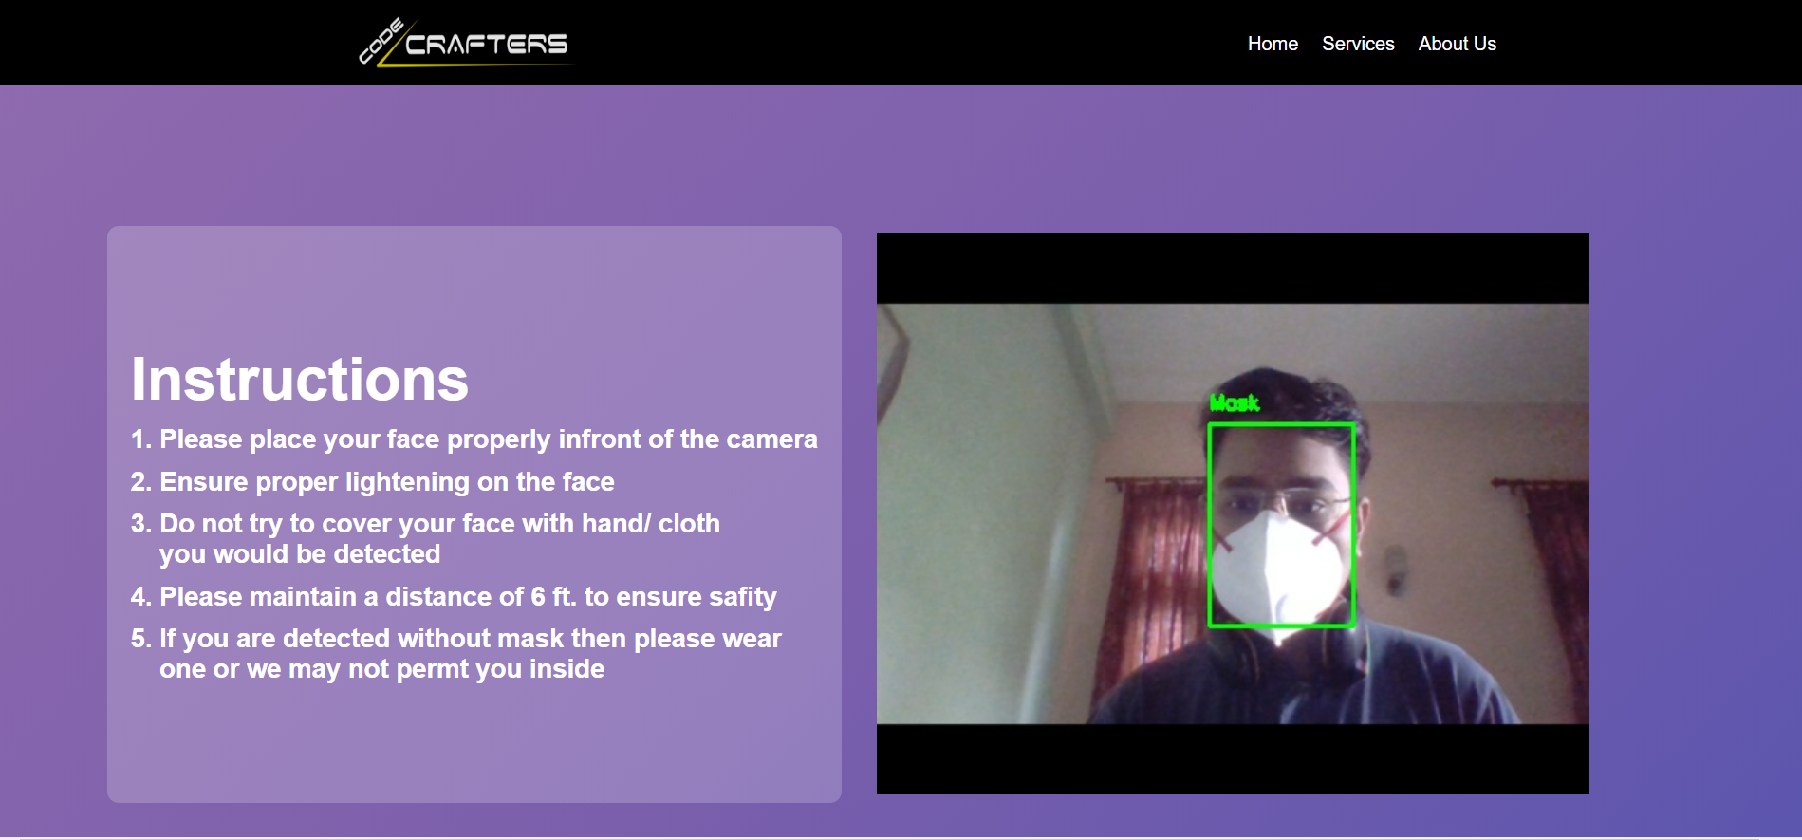
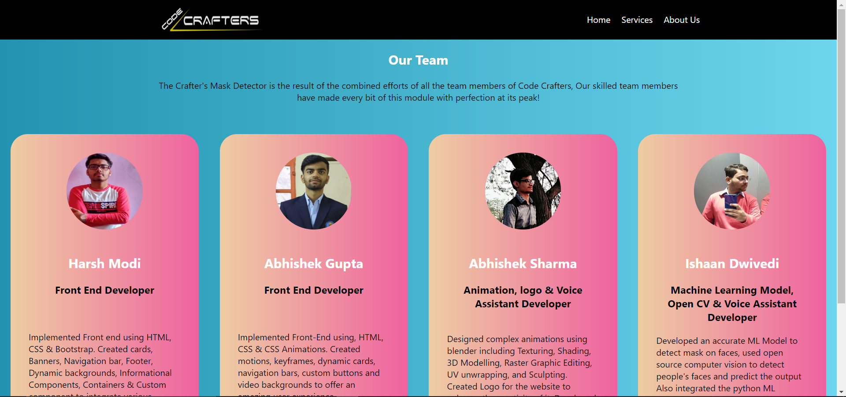
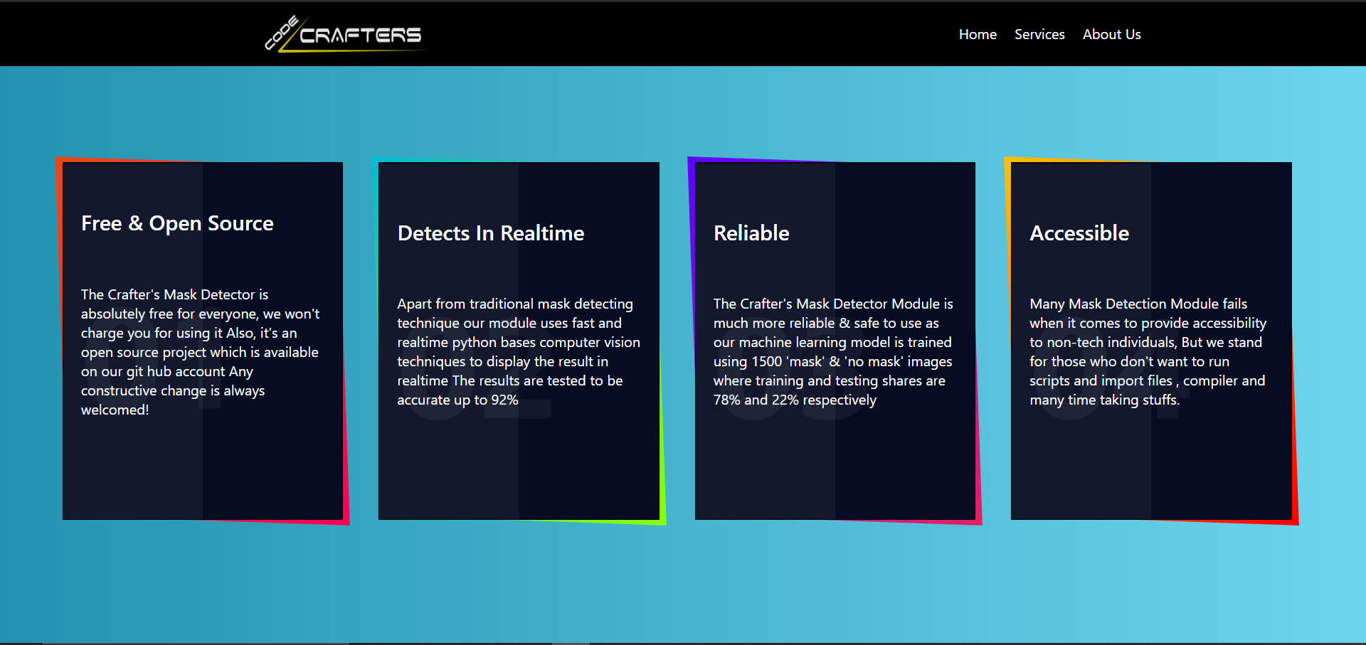
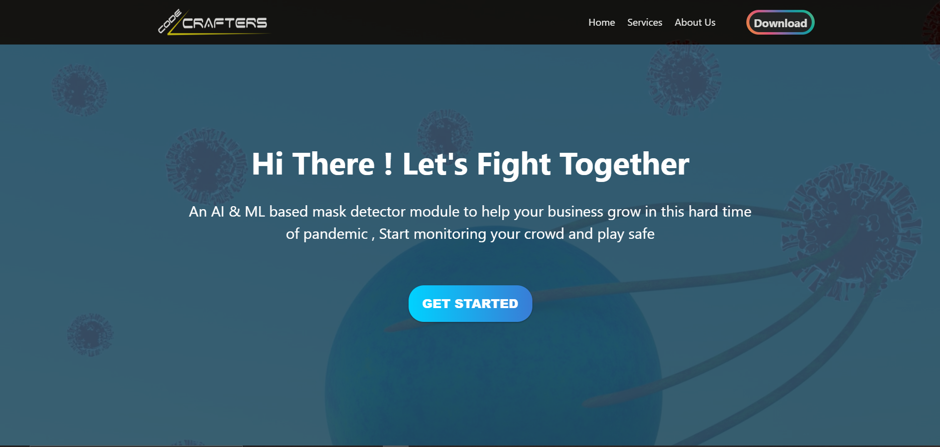
The Modern Look !

Slide 9




What We Learnt
1
2
3
4
Professional Teamwork
Building
A ML Model
Building Complex UI
Using Flask

Slide 10
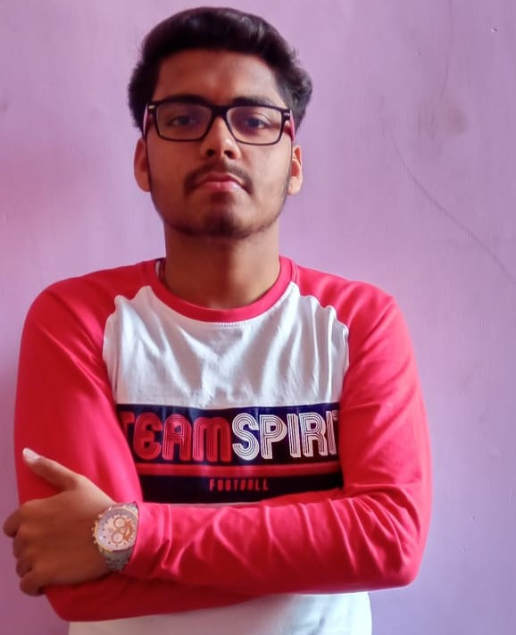
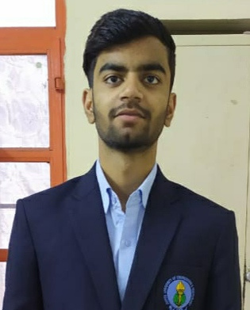
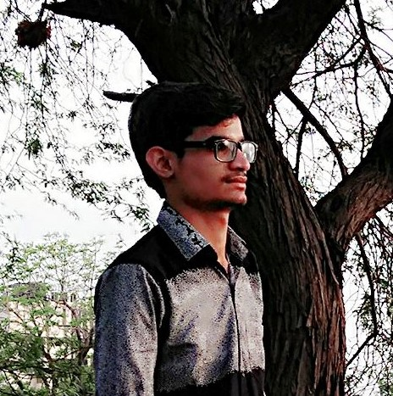
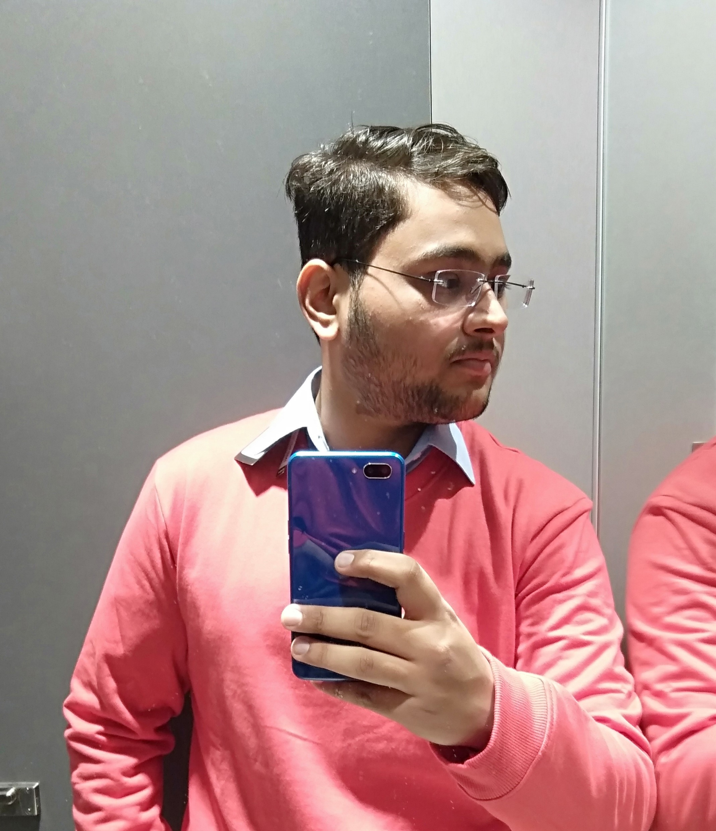
The Code Crafters
01
02
03
04
Harsh Modi
Abhishek Gupta
Abhishek Sharma
Ishaan Dwivedi
Front End Developer &
UI Designer
Front End Developer &
UI Designer
Animation, Logo & Voice Assistant Developer
Web Integration & ML Model Developer

Slide 11



T H A N K S F O R W A T C H I N G
CodeCrafters
@CodeCrafters

